Slide 1

Structure of Events & Dependence

Slide 2
Structure of Events
1

Slide 3
Structure of Events
Suppose Aline and Archana play a card game. The person that picks the highest card wins the game.
Assume that Aline may go first. Then the structure of events can be defined as follows:
Struct_Events = (“Aline Picks a Card”, “Archana Picks a Card”.)

Slide 4
Order, order
2

Slide 5
Order, order
The order of a structure of events is important. Why?
Because in some cases the order changes your chances of winning.

Slide 6
Order, order
Say that Aline and Archana play a game using only the Hearts from a deck of 52 cards (a total of 13 cards). The player that picks the highest card wins the game.
Struct_Events = (“Player1”, “Player2”) = (“Aline Picks a Card”, “Archana Picks a Card”.)

Slide 7
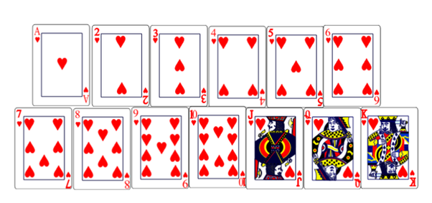
Order, order
Struct_Events = (“Aline Picks a Card”, “Archana Picks a Card”.)
Suppose Aline needs to pick a card. How likely will it be that she picks the King of Hearts (the highest possible card)?
Before actually picking a card, the chance of picking a King of Hearts is 1/13.

Slide 8
Order, order
Suppose now that the following happens:
Aline picks the 3 of Hearts and puts it on the table.
Now it’s Archana’s turn.

Slide 9
Order, order
Given that it’s Archana’s turn. How likely will it be that she picks the King of Hearts (the highest possible card)?
A priori, her chance of picking a King of Hearts is 1/12.

Slide 10
Order, order
Thus, after Aline picked her card, the chances of Archana of picking a King of Hearts relative to Aline’s chances of picking that card went up.
Suppose that Aline did pick the King of Hearts. What are Archana’s chances of picking the King of Hearts?

Slide 11
Order determines chance
3

Slide 12
Order determines chance
The order of a structure of events is important. Why?
By removing one card from the card deck, the space of possible outcomes, Ω, becomes smaller. Hence, the probability of picking any given card will be higher (1/12 instead of 1/13) assuming that the other player did not already pick that card.

Slide 13
Order determines chance
In statistics and probability we say that - when the order or structure of events matters - we have a dependency of events.
In other words, if the occurrence of one event change something in another event, there is a “connection” between the two events.

Slide 14
Order determines chance
What would be examples of games/cases whereby Archana’s chances of winning are independent of whatever Aline does?
Throwing a dice;
Picking a card after Aline put it back hers;
Coin flip;
….

Slide 15
The End.

